Slide 1

Data Structure Design Specification
This presentation outlines the essential components of designing a comprehensive data structure specification, encompassing its fundamental properties, operations, and complexity analysis.

Slide 2

Identify the Data Structures
1
Arrays
2
Linked Lists
Arrays are linear data structures that store elements of the same data type in contiguous memory locations, allowing for efficient access based on index.
Linked lists are linear data structures where each element, known as a node, contains data and a pointer to the next node, providing flexibility in memory allocation and dynamic size.
3
Trees
4
Graphs
Trees are hierarchical data structures that consist of nodes connected by edges, representing a parent-child relationship, facilitating efficient searching and sorting algorithms.
Graphs are non-linear data structures representing relationships between entities, where nodes represent entities and edges represent connections, allowing for modeling complex networks.

Slide 3
Define the Operations
Insertion
Deletion
Search
Adding new data elements to the data structure, potentially at a specific location or according to predefined rules.
Removing data elements from the data structure based on specific criteria, such as value, index, or position.
Locating a specific data element within the structure, often using search algorithms tailored to the structure's organization.

Slide 4

Specify Input Parameters
1
Data Type
Specifies the type of data elements that the data structure can store, ensuring data consistency and integrity.
2
Size
Defines the maximum number of elements that the data structure can hold, influencing memory allocation and performance.
3
Initial Value
Specifies the initial value or state of the data structure, potentially influencing its subsequent operations.

Slide 5

Define Pre- and Post-conditions
Pre-conditions
Post-conditions
Conditions that must hold true before an operation is executed, ensuring the operation's validity and preventing unexpected outcomes.
Conditions that must hold true after an operation is completed, guaranteeing the operation's desired effects and validating its success.

Slide 6

Discuss Time and Space Complexity
Operation
Time Complexity
Space Complexity
Insertion
O(1) - Constant
O(1) - Constant
Deletion
O(n) - Linear
O(1) - Constant
Search
O(n) - Linear
O(1) - Constant

Slide 7



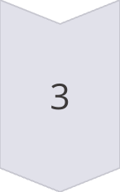
Provide Examples and Code Snippets (if applicable)
Example 1: Array
int arr[5] = {1, 2, 3, 4, 5};
Example 2: Linked List
struct Node { int data; Node* next; };
Example 3: Tree
class TreeNode { int data; TreeNode* left; TreeNode* right; };

Slide 8

Memory Stack: A Fundamental Concept
A memory stack is a data structure that follows the Last-In, First-Out (LIFO) principle. This means the last item added to the stack is the first one to be removed.

Slide 9

Stack Operations: Push, Pop, and Peek
1
Push
2
Pop
The push operation adds a new element to the top of the stack.
The pop operation removes the top element from the stack.
3
Peek
The peek operation retrieves the top element without removing it.

Slide 10
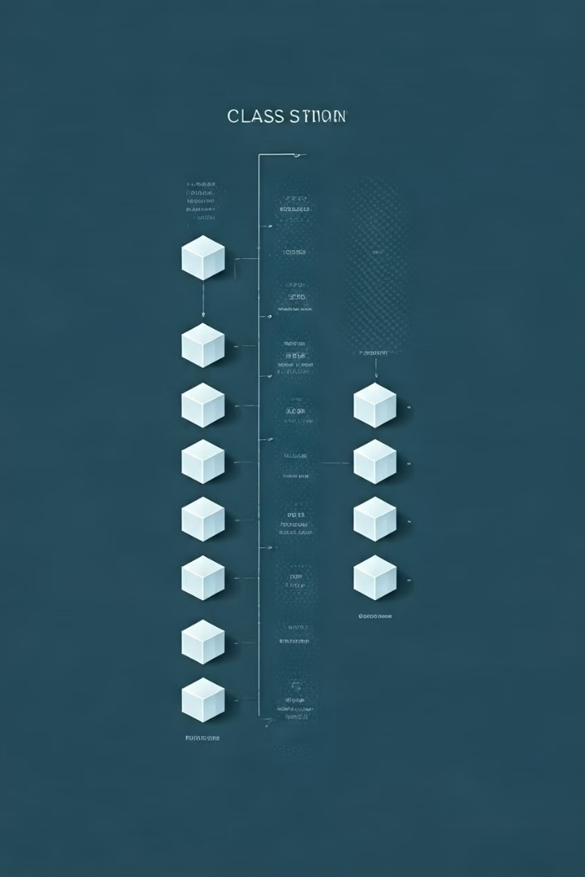


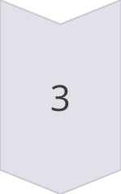
Function Calls and the Stack
Function Call
When a function is called, its parameters, local variables, and return address are pushed onto the stack.
Function Execution
The function then uses the stack to access its data and perform operations.
Return
When the function completes, the stack is popped to restore the previous state and return control.

Slide 11
Stack Frames: The Building Blocks of Function Execution
Local Variables
Parameters
Return Address
Each function call creates its own stack frame, which stores local variables that are only accessible within the function's scope.
Parameters passed to the function are stored on the stack frame, allowing the function to access the values.
The return address is a pointer to the instruction where the program should resume after the function finishes executing.

Slide 12

The Significance of the Memory Stack
Efficient Function Calls
Recursive Functions
The stack enables seamless function calls and returns, preserving the state of the program and preventing conflicts.
Stacks are essential for supporting recursive functions, where a function calls itself, creating multiple nested stack frames.
Error Handling
Stacks are crucial for exception handling, allowing the program to unwind the stack and revert to a safe state.

Slide 13

Introduction to FIFO Queues
FIFO queues are a fundamental data structure that follows the First-In, First-Out (FIFO) principle, similar to a waiting line at a store. Elements are added to the rear of the queue and removed from the front, ensuring that the oldest element is processed first.

Slide 14

Definition of a FIFO Queue
Key Characteristics
Operations
FIFO queues are linear data structures that maintain a specific order of elements.
Common operations include enqueue (adding an element), dequeue (removing an element), peek (accessing the front element without removing it), and isEmpty (checking if the queue is empty).

Slide 15
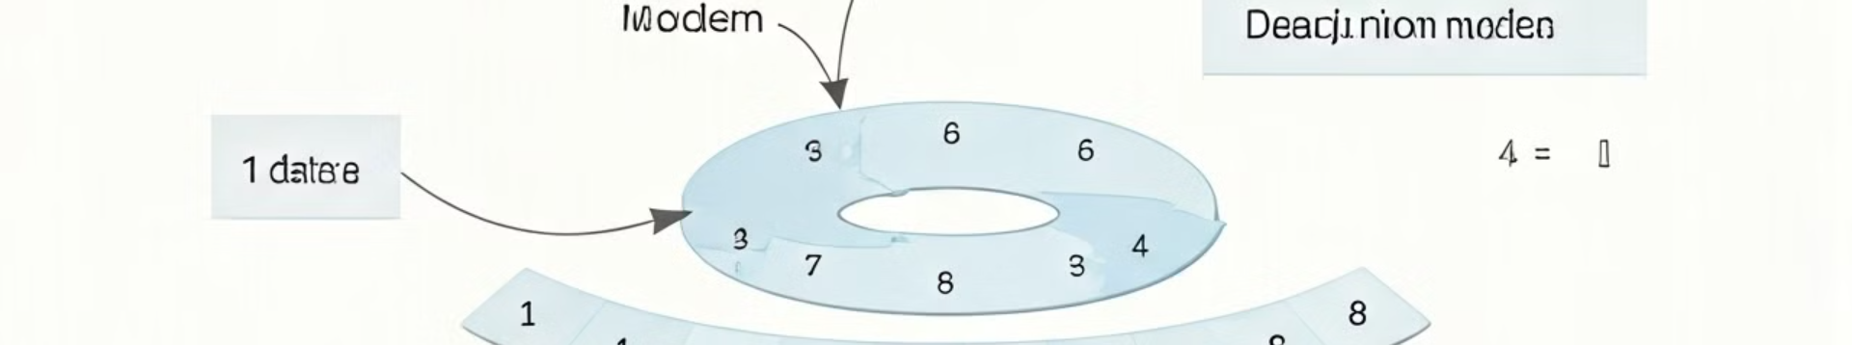



Array-Based Implementation of a FIFO Queue
Enqueue
Dequeue
Circular Buffer
Add a new element to the rear of the queue, incrementing the rear pointer.
Remove the element at the front of the queue, incrementing the front pointer.
When the rear pointer reaches the end of the array, it wraps back to the beginning to efficiently utilize the available space.

Slide 16
Linked List-Based Implementation of a FIFO Queue
Nodes
Pointers
Dynamic Size
Each node in the linked list contains data and a pointer to the next node.
The front pointer points to the first node, and the rear pointer points to the last node in the list.
Linked list implementation allows the queue to dynamically adjust its size, eliminating the fixed-size limitations of arrays.

Slide 17

Concrete Example Illustrating the FIFO Queue in Action
Operation
Queue
Initial state
[]
Enqueue 1
[1]
Enqueue 2
[1, 2]
Enqueue 3
[1, 2, 3]
Dequeue
[2, 3]
Dequeue
[3]

Slide 18

Comparing Two Sorting Algorithms
This presentation compares two popular sorting algorithms: Merge Sort and Quick Sort. We'll delve into their characteristics, analyze their complexities, and examine their performance in different scenarios.

Slide 19

Introduction to Sorting Algorithms
1
Merge Sort
2
Quick Sort
A divide-and-conquer algorithm that recursively divides the input array into halves, sorts them, and merges the sorted halves.
A divide-and-conquer algorithm that selects a pivot element, partitions the array around the pivot, and recursively sorts the sub-arrays.

Slide 20
Time Complexity Analysis
Merge Sort
Quick Sort
Has a consistent time complexity of O(n log n) in all cases, making it a reliable choice for sorting large datasets.
Has an average time complexity of O(n log n), but its worst-case complexity can reach O(n^2) if the pivot selection is not optimized.

Slide 21
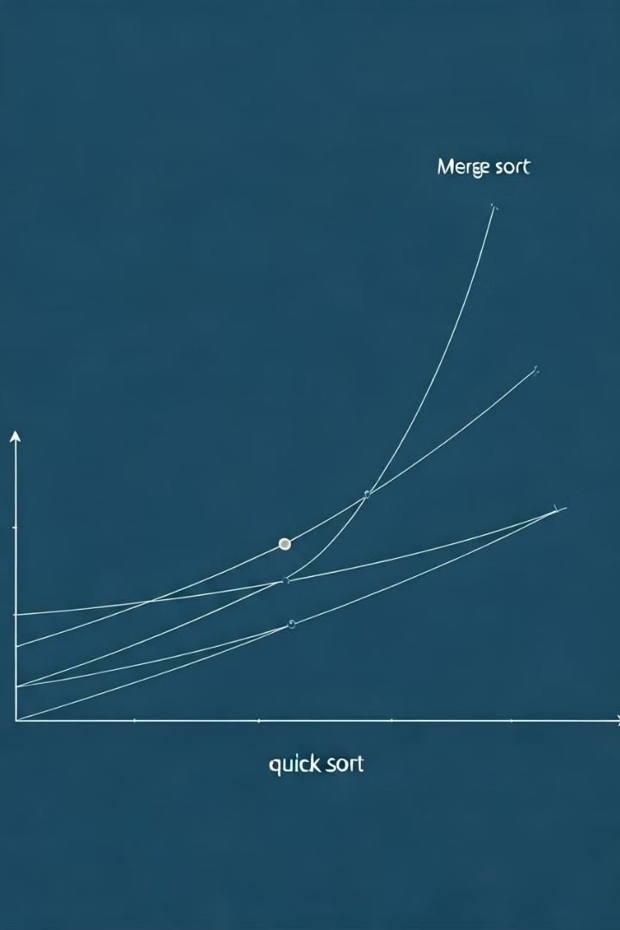
Space Complexity Analysis
Merge Sort
Quick Sort
Requires O(n) auxiliary space for storing the merged sub-arrays during the sorting process.
Typically has an average space complexity of O(log n), but it can reach O(n) in the worst-case scenario.

Slide 22
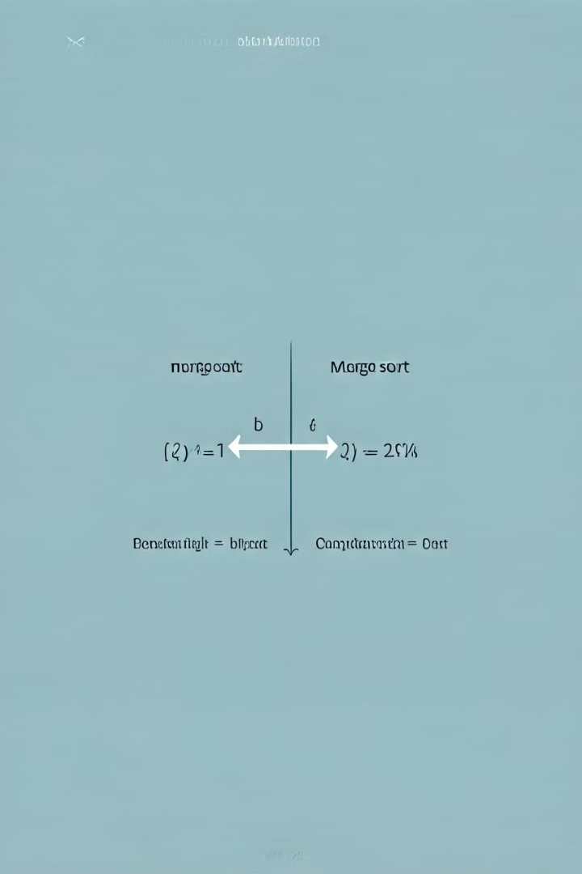
Stability Comparison
Merge Sort
Stable sorting algorithm, meaning equal elements maintain their original relative order after sorting.
Quick Sort
Unstable sorting algorithm, meaning equal elements might not retain their original order after sorting.

Slide 23
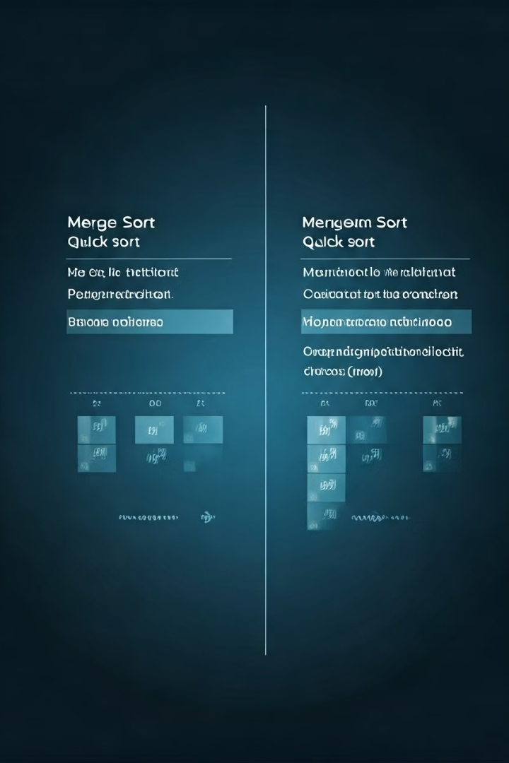
Algorithmic Comparison Table
Algorithm
Time Complexity (Average)
Time Complexity (Worst Case)
Space Complexity
Stability
Merge Sort
O(n log n)
O(n log n)
O(n)
Stable
Quick Sort
O(n log n)
O(n^2)
O(log n)
Unstable

Slide 24
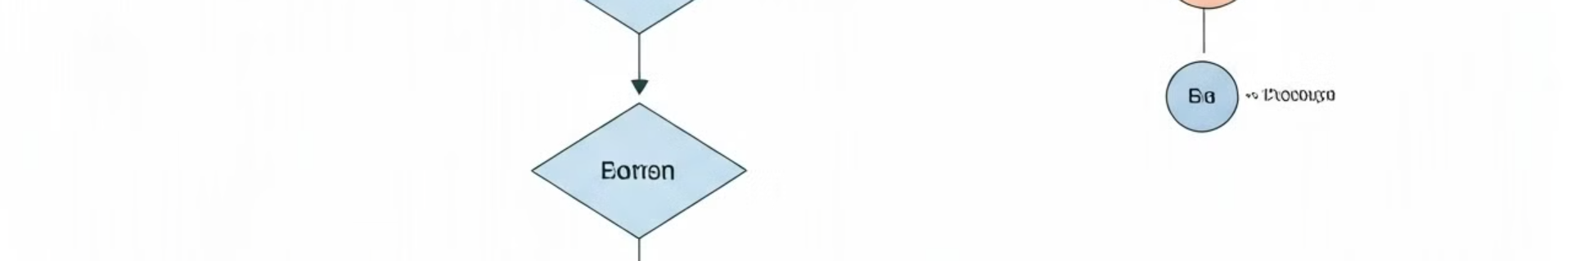
Performance Comparison Methodology
Dataset Selection
Execution Time Measurement
A range of datasets, including randomly generated arrays and arrays with specific properties, will be used.
Execution times for each algorithm on different datasets will be recorded and analyzed to assess their performance.
1
2
3
Implementation
The algorithms will be implemented in a consistent programming language and environment to ensure fair comparison.

Slide 25



Performance Comparison Results
Merge Sort
Quick Sort
Generally outperforms Quick Sort in terms of consistent performance across various dataset sizes and distributions.
Can be faster than Merge Sort for smaller datasets, but its performance can degrade significantly in the worst-case scenarios.

Slide 26

Concrete Example Walkthrough
Let's illustrate with a simple array: [5, 2, 8, 1, 9]. We'll walk through how both Merge Sort and Quick Sort would sort this array.

Slide 27
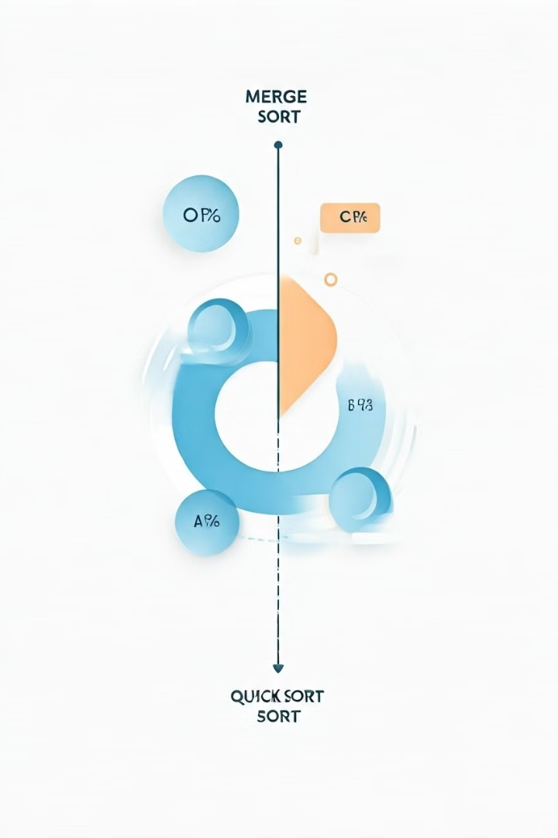
Conclusion and Key Takeaways
Both Merge Sort and Quick Sort are effective sorting algorithms with distinct characteristics. The choice between them depends on the specific application and the desired performance trade-offs.

Slide 28

Network Shortest Path Algorithms
Network shortest path algorithms are used to find the shortest path between two nodes in a network. They are used in many applications, including mapping, routing, and transportation.

Slide 29

Introduction to Network Shortest Path Algorithms
1
Network Representation
2
Shortest Path Problem
A network is represented as a graph with nodes and edges, each edge having a weight representing the distance or cost between two nodes.
The goal is to find the shortest path between a source and destination node, minimizing the total weight along the path.
3
Applications
Shortest path algorithms have diverse applications in areas like GPS navigation, network routing, and transportation planning.

Slide 30

Dijkstra's Algorithm
1
2
3
Initialization
Exploration
Termination
Start by setting the distance to the source node to 0 and all other nodes to infinity.
Iteratively select the node with the shortest distance and update the distances to its neighbors.
The algorithm terminates when all nodes have been visited or the destination node has been reached.

Slide 31
Illustrating Dijkstra's Algorithm
Step 1
Step 2
Step 3
Initialize the distances to the source node. Nodes not directly connected have infinity distances.
Explore the neighbors of the source node and update their distances.
Repeat the exploration process, selecting the node with the smallest distance and updating its neighbors.

Slide 32
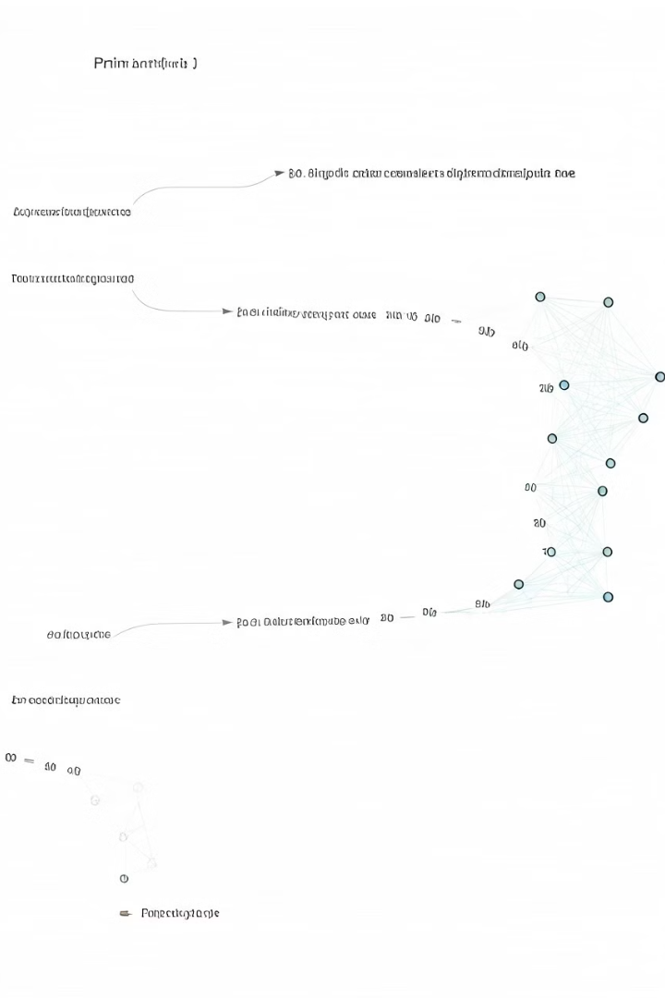
Prim-Jarnik Algorithm
Initialization
Start with an empty minimum spanning tree (MST) and a single node.
Edge Selection
Select the edge with the minimum weight connecting a node in the MST to a node not in the MST.
Tree Expansion
Add the selected edge and its corresponding node to the MST.

Slide 33

Illustrating Prim-Jarnik Algorithm
Step 1
Start with an empty MST and a single node.
Step 2
Select the edge with the minimum weight connecting a node in the MST to a node not in the MST.
Step 3
Add the selected edge and its corresponding node to the MST. Repeat until all nodes are included.

Slide 34
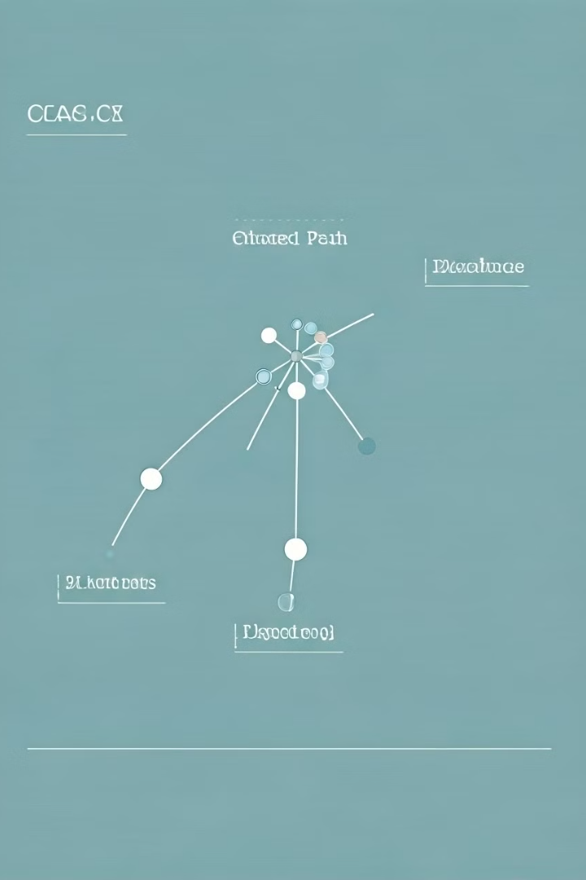
Example of Dijkstra's Algorithm
Scenario
Process
Finding the shortest path from node A to node F in a network with specific edge weights.
Applying Dijkstra's algorithm, the distances to each node are updated step-by-step, leading to the shortest path: A-B-D-F.

Slide 35



Example of Prim-Jarnik Algorithm
Scenario
Process
Finding the minimum spanning tree for a network with specific edge weights.
Applying the Prim-Jarnik algorithm, the minimum weight edges are progressively added to the tree, resulting in a connected structure with minimum total edge weight.

Slide 36
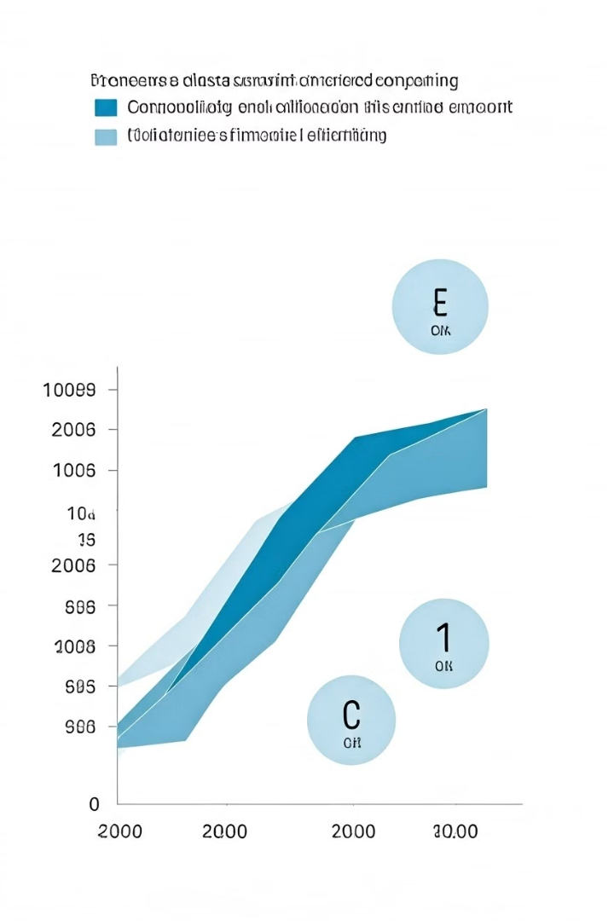
Performance Analysis
1
Time Complexity
2
Space Complexity
Dijkstra's algorithm typically has a time complexity of O(E log V), where E is the number of edges and V is the number of nodes.
Both algorithms require additional space to store distances and other information, making their space complexity dependent on the size of the network.
3
Efficiency
The efficiency of these algorithms can vary depending on the specific network structure and the size of the data set.

